Slide 1
6. Sorting

Slide 2
Objectives
Elementary Sorting Algorithms
Selection Sort
Insertion Sort
Bubble Sort
Efficient Sorting Algorithms
Quick Sort
Merge Sort
Heap sort
Radix Sort
Sorting in java.util

Slide 3
Elementary Sorting Algorithms

Slide 4
Selection Sort
Selection sort is an attempt to localize the exchanges of array elements by finding a misplaced element first and putting it in its final place
selectionsort(data[])
for i = 0 to data.length-2
select the smallest (or largest) element data[k] among
data[i], . . . , data[data.length-1];
swap data[i] with data[k];
Complexity O(n²)

Slide 5
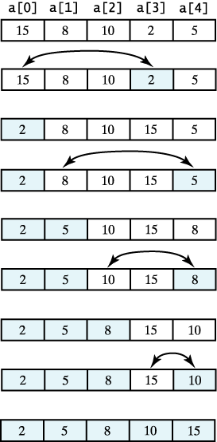
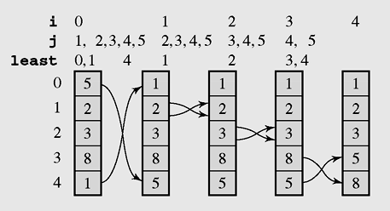
Selection Sort example
A selection sort of an array of integers into ascending order.
The array [5 2 3 8 1] sorted by selection sort

Slide 6
Selection sort code
void selectSort() //Simple Selection Sort
{ int i,j,k;int min;
for(i=0;i<n-1;i++)
{ min=a[i];k=i;
for(j=i+1;j<n;j++)
if(a[j]<min) {k=j;min=a[j];}
if(k!=i) swap(a,i,k);
}
}

Slide 7
Insertion sort algorithm
An insertion sort starts by considering the first elements of the array data, which is data[0]
Next, for i=1,2,…,n-1 insert data[i]into the sorted sub-array before i:
insertionsort(data[]) {
for i = 1 to data.length–1
tmp = data[i];
move all elements data[j] greater than tmp by one position;
place tmp in its proper position;
Complexity O(n²)
Best case O(n)

Slide 8
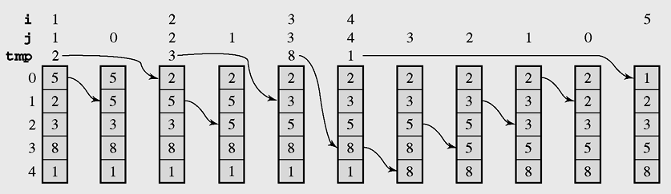
Insertion sort example
The array [5 2 3 8 1] sorted by insertion sort

Slide 9
Insertion sort code
void insertSort()
{ int i,j,x;
for(i=1;i<n;i++)
{ x=a[i]; j=i;
while(j>0 && x<a[j-1])
{ a[j]=a[j-1]; j--;
};
a[j]=x;
}
}
}

Slide 10
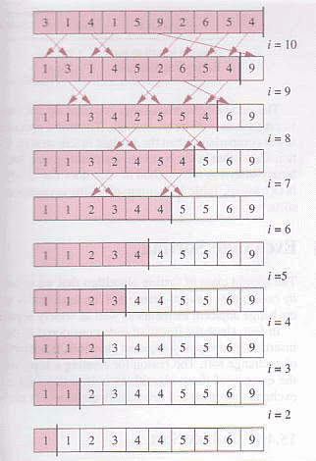
Bubble sort
void bubbleSort()
{ int i; boolean swapped;
do
{ swapped=false;
for(i=0;i<n-1;i++)
if(a[i]>a[i+1])
{ swap(a,i,i+1);
swapped=true;
}
}
while(swapped);
}
Complexity O(n²)
Best case O(n)

Slide 11
Efficient Sorting Algorithms

Slide 12
Quicksort - 1
Efficient sorting algorithm
Discovered by C.A.R. Hoare
Example of Divide and Conquer algorithm
Two phases
Partition phase
Divides the work into half
Sort phase
Conquers the halves!

Slide 13
Quicksort - 2
Partition
Choose a pivot
Find the position for the pivot so that
all elements to the left are less
all elements to the right are greater
≤ pivot
pivot
> pivot
Conquer
Apply the same algorithm to each half
≤ pivot
> pivot
≤ p’
p’
> p’
pivot
≤ p”
p”
> p”

Slide 14
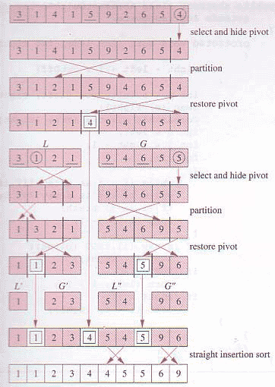
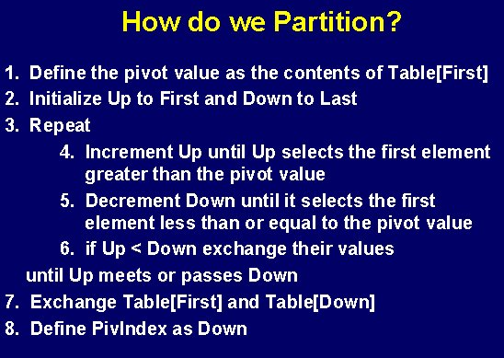
Quicksort - 3

Slide 15
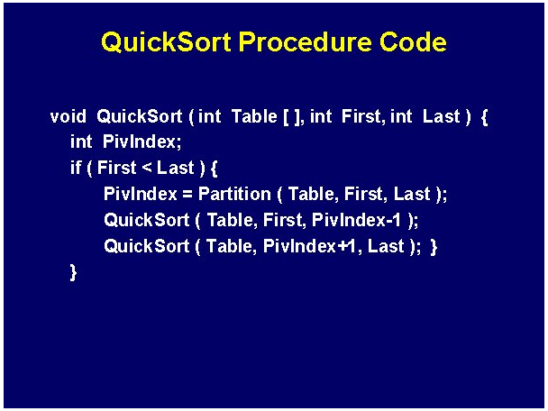
Quicksort code

Slide 16
Quicksort complexity
Quick Sort
In the best case and average case: O(n log n) but ….
Can be O(n²), the (rear) worst case. Moreover, the constant hidden in the O-notation is small.
Depends on pivot selection
Median-of-3
Random pivot
Better but not guaranteed

Slide 17
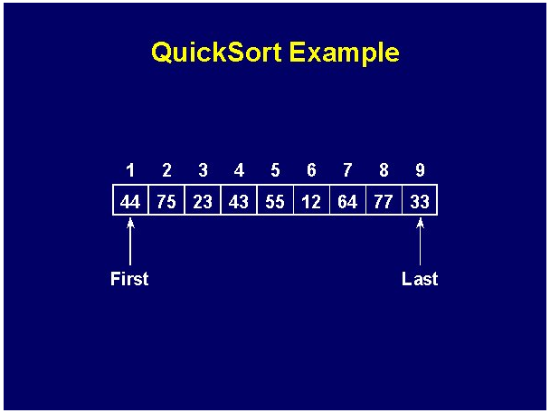
Quicksort example - 1

Slide 18
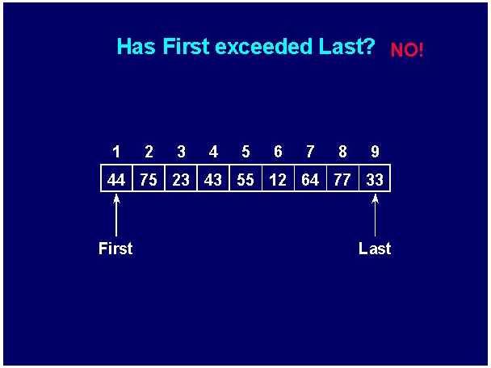
Quicksort example - 2

Slide 19
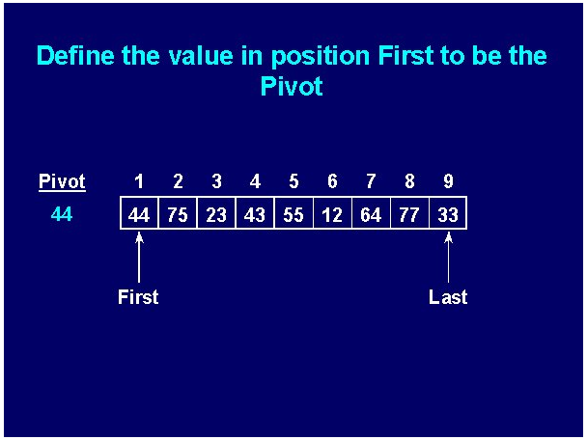
Quicksort example - 3

Slide 20
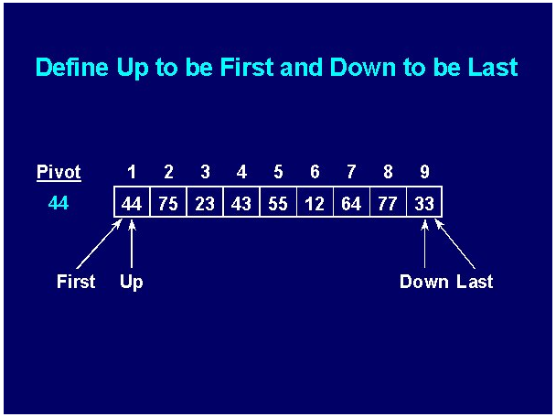
Quicksort example - 4

Slide 21
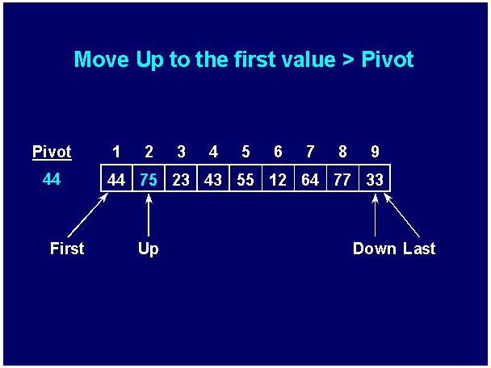
Quicksort example - 5

Slide 22
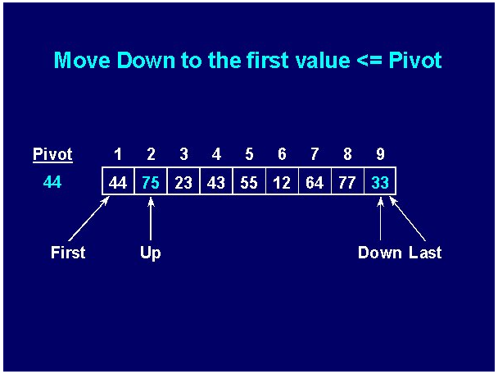
Quicksort example - 6

Slide 23
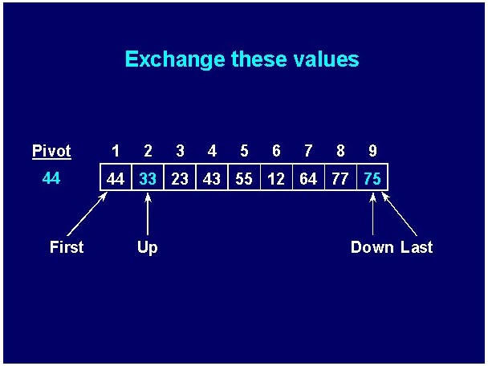
Quicksort example - 7

Slide 24


Quicksort example - 8

Slide 25
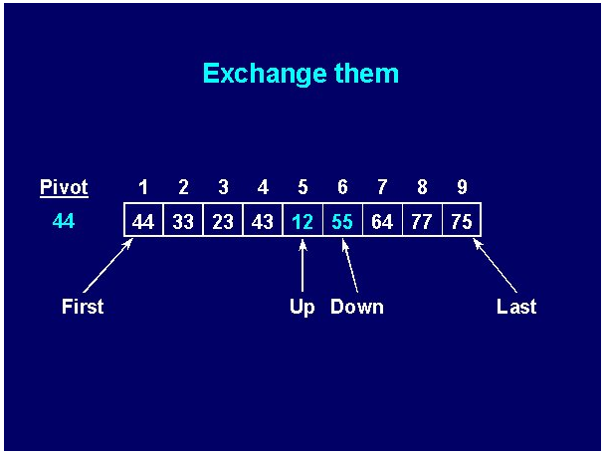
Quicksort example - 9

Slide 26


Quicksort example - 10

Slide 27
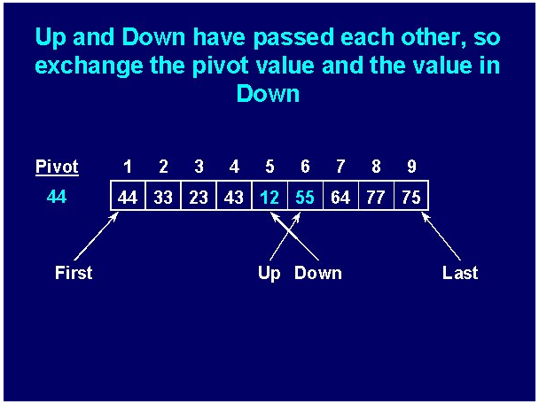
Quicksort example - 11

Slide 28
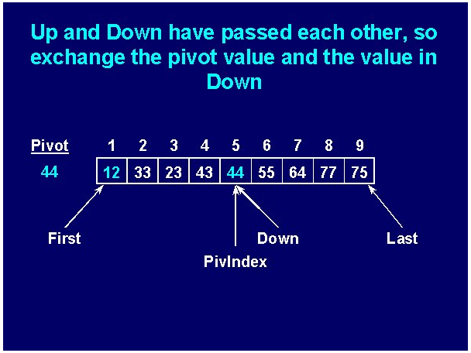
Quicksort example - 12

Slide 29
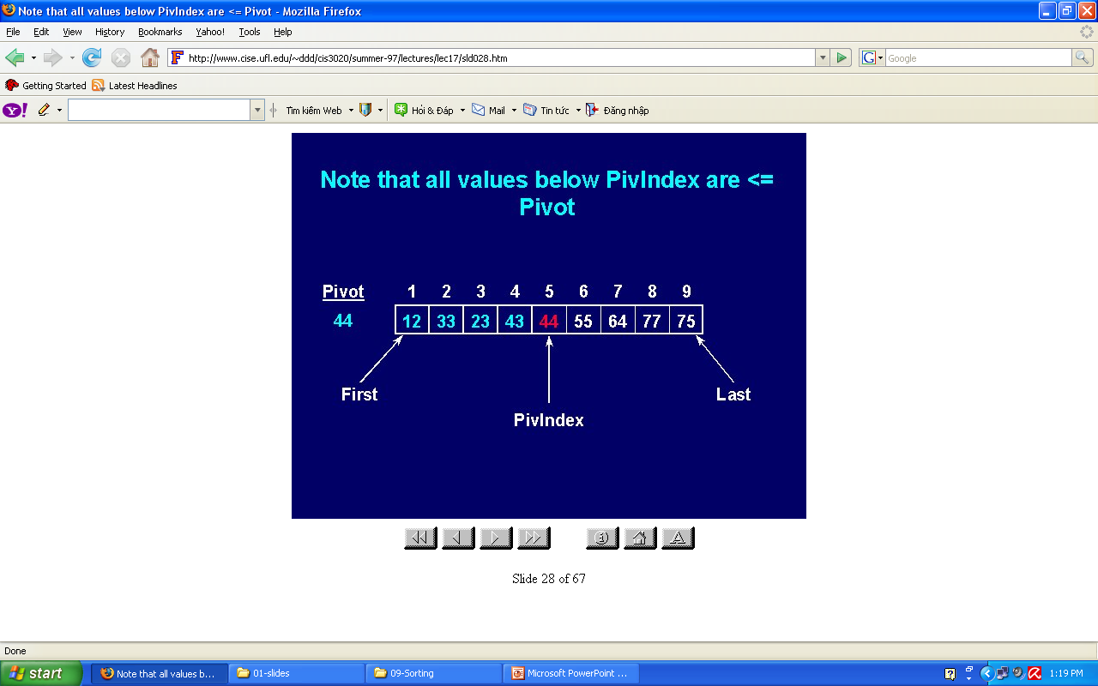
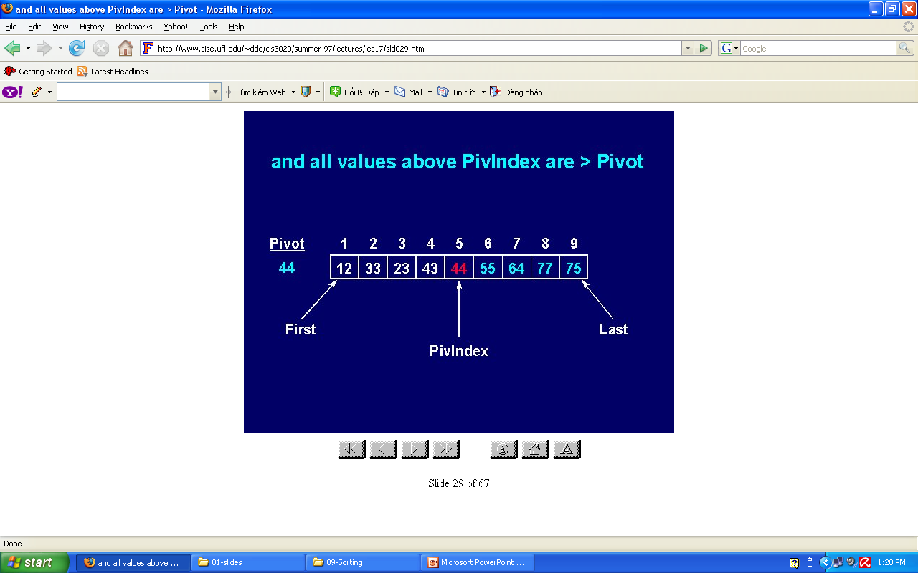
Quicksort example - 13

Slide 30
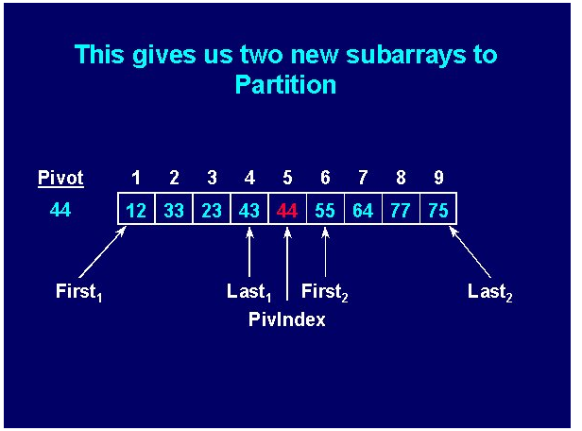
Quicksort example - 14

Slide 31
Mergesort
Mergesort makes partitioning as simple as possible and concentrates on merging sorted halves of an array into one sorted array
Complexity is O(nlogn)
It was one of the first sorting algorithms used on a computer and was developed by John von Neumann
mergesort(data)
if data have at least two elements
mergesort(left half of data);
mergesort(right half of data);
merge(both halves into a sorted list);

Slide 32
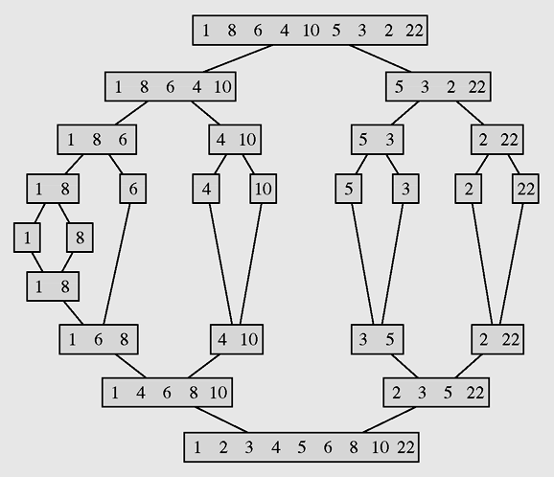
Mergesort example
The array [1 8 6 4 10 5 3 2 22] sorted by mergesort

Slide 33
Merge sort code
void mergeSort(int p, int r)
{if(p>=r) return;
int q = (p+r)/2;
mergeSort(p,q);
mergeSort(q+1,r);
merge(p,q,r);
}
void merge(int p, int q, int r)
{if(!(p<=q) && (q<=r)) return;
int n,i,j,k,x; n = r-p+1;
int [] b = new int[n];
i=p;j=q+1;k=0;
while(i<=q && j<=r)
{if(a[i]<a[j])
b[k++] = a[i++];
else
b[k++] = a[j++];
}
while(i<=q) b[k++] = a[i++];
while(j<=r) b[k++] = a[j++];
k=0;
for(i=p;i<=r;i++) a[i] = b[k++];
}
public class Main
{public static void main(String args[])
{int [] b = {7,3,5,9,11,8,6,15,10,12,14};
EffSort t = new EffSort(b);
int n=b.length;
t.mergeSort(0,n-1);t.display();
System.out.println();
}
}

Slide 34
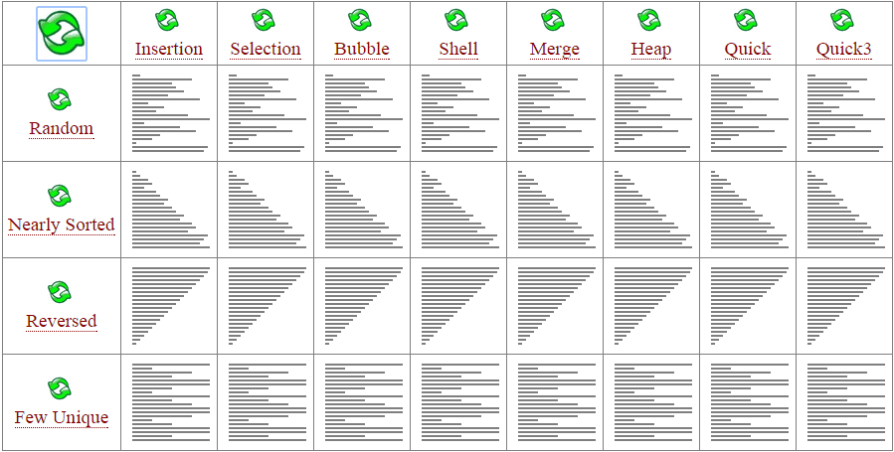
Merge sort code
void mergeSort(int p, int r)
{if(p>=r) return;
int q = (p+r)/2;
mergeSort(p,q);
mergeSort(q+1,r);
merge(p,q,r);
}
void merge(int p, int q, int r)
{if(!(p<=q) && (q<=r)) return;
int n,i,j,k,x; n = r-p+1;
int [] b = new int[n];
i=p;j=q+1;k=0;
while(i<=q && j<=r)
{if(a[i]<a[j])
b[k++] = a[i++];
else
b[k++] = a[j++];
}
while(i<=q) b[k++] = a[i++];
while(j<=r) b[k++] = a[j++];
k=0;
for(i=p;i<=r;i++) a[i] = b[k++];
}
public class Main
{public static void main(String args[])
{int [] b = {7,3,5,9,11,8,6,15,10,12,14};
EffSort t = new EffSort(b);
int n=b.length;
t.mergeSort(0,n-1);t.display();
System.out.println();
}
}

Slide 35
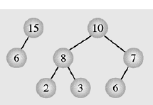
Heap data structure - 1
Heap is a particular kind of binary tree, which has two properties:
The value of each node is greater than or equal to the values stored in each of its children.
If the height of the tree is h, then the tree is complete at level d for d = 1, 2, ..., h-1, and the leaves in the last level are all in the leftmost positions
(This kind of binary tree is called nearly complete binary tree)
These two properties define a max heap
If “greater” in the first property is replaced with “less,” then the definition specifies a min heap

Slide 36
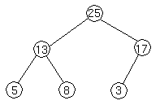
Heap data structure - 2
We can represent heap by array in level order, going from left to right. The array corresponding to the heap above is [25, 13, 17, 5, 8, 3].
The root of the tree a[0] and given index i of a node, the indices of its parent, left child and right child can be computed:
PARENT (i) return floor((i-1)/2) LEFT (i) return 2i+1 RIGHT (i) return 2(i + 1)

Slide 37
Heap Sort - 1
Heap sort consists of 2 steps:
Transform the array to a heap:
Suppose the array a to be sorted has n elements: a[0], a[1], ..., a[n-1]
At first the heap has only one element: a[0]. Then
for i =1 to n-1 we insert the element a[i] to heap so that the heap property is maintained.
Transform the heap to sorted array:
for k = 1 to n-1 do
remove and put the root (a[0]) to the position n-k, then rearrange elements to keep the heap property.

Slide 38
Heap sort code
Addition and deletion are both O(logn) operations. We need to perform n additions and deletions, leading to an O(nlogn) algorithm.
//Transform the array to HEAP
int i,s,f;int x;
for(i=1;i<n;i++)
{ x=a[i]; s=i; //s is a son, f=(s-1)/2 is father
while(s>0 && x>a[(s-1)/2])
{ a[s]=a[(s-1)/2]; s=(s-1)/2;
};
a[s]=x;
};
// Transform heap to sorted array
for(i=n-1;i>0;i--)
{ x=a[i];a[i]=a[0];
f=0; //f is father
s=2*f+1; //s is a left son
// if the right son is larger then it is selected
if(s+1<i && a[s]<a[s+1]) s=s+1;
while(s<i && x<a[s])
{ a[f]=a[s]; f=s; s=2*f+1;
if(s+1<i && a[s]<a[s+1]) s=s+1;
};
a[f]=x;
};
Complexity O(nlog₂n)

Slide 39
Bucket Sort
Bucket sort is a sorting technique that involves dividing elements into various groups, or buckets.
These buckets are formed by uniformly distributing the elements.
Once the elements are divided into buckets, they can be sorted using any other sorting algorithm.
Finally, the sorted elements are gathered together in an ordered fashion.

Slide 40
Bucket Sort Algorithm
Create n empty buckets (or lists) and do the following for every array element arr[i].
Insert arr[i] into bucket[n*array[i]]
Sort individual buckets (E.g. insertion sort).
Concatenate all sorted buckets.

Slide 41
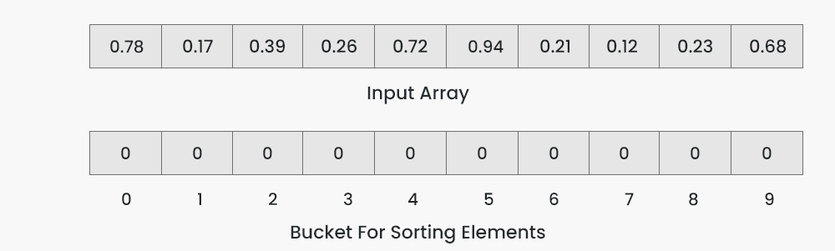
Bucket Sort Algorithm
To apply bucket sort on the input array [0.78, 0.17, 0.39, 0.26, 0.72, 0.94, 0.21, 0.12, 0.23, 0.68], we follow these steps:
Step 1: Create an array of size 10, where each slot represents a bucket.

Slide 42
Bucket Sort Algorithm
Step 2: Insert elements into the buckets from the input array based on their range. Inserting elements into the buckets:
Take each element from the input array.
Multiply the element by the size of the bucket array (10 in this case). For example, for element 0.23, we get 0.23 * 10 = 2.3.
Convert the result to an integer, which gives us the bucket index. In this case, 2.3 is converted to the integer 2.
Insert the element into the bucket corresponding to the calculated index.
Repeat these steps for all elements in the input array.
bucket[n*array[i]]

Slide 43
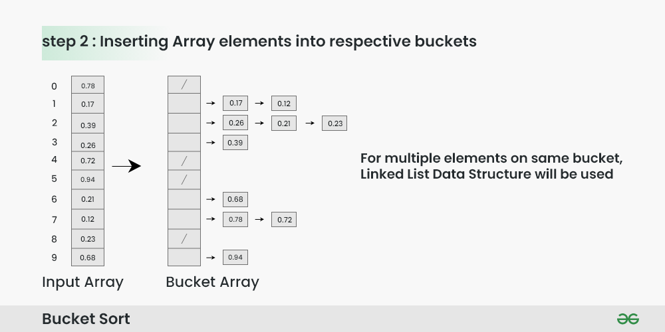
Bucket Sort Algorithm
Step 2: Insert elements into the buckets
bucket[n*array[i]]

Slide 44
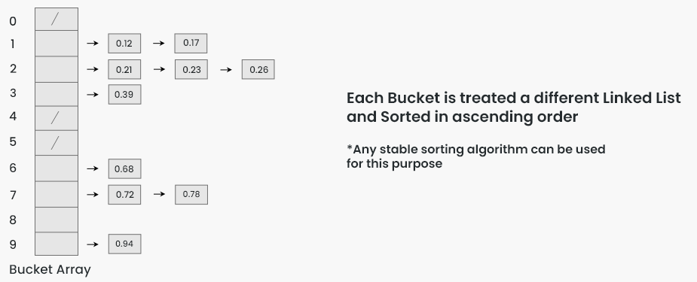
Bucket Sort Algorithm
Step 3: Sort the elements within each bucket. In this example, we use quicksort (or any stable sorting algorithm) to sort the elements within each bucket. Sorting the elements within each bucket:
Apply a stable sorting algorithm (e.g., Bubble Sort, Merge Sort) to sort the elements within each bucket.
The elements within each bucket are now sorted.

Slide 45
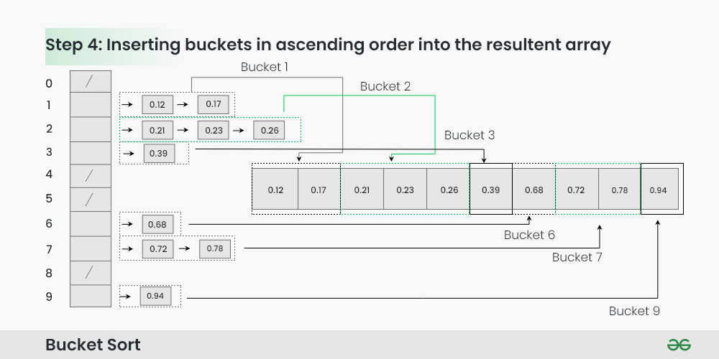
Bucket Sort Algorithm
Step 4: Gather the elements from each bucket and put them back into the original array. Gathering elements from each bucket:
Iterate through each bucket in order.
Insert each individual element from the bucket into the original array.
Once an element is copied, it is removed from the bucket.
Repeat this process for all buckets until all elements have been gathered.

Slide 46
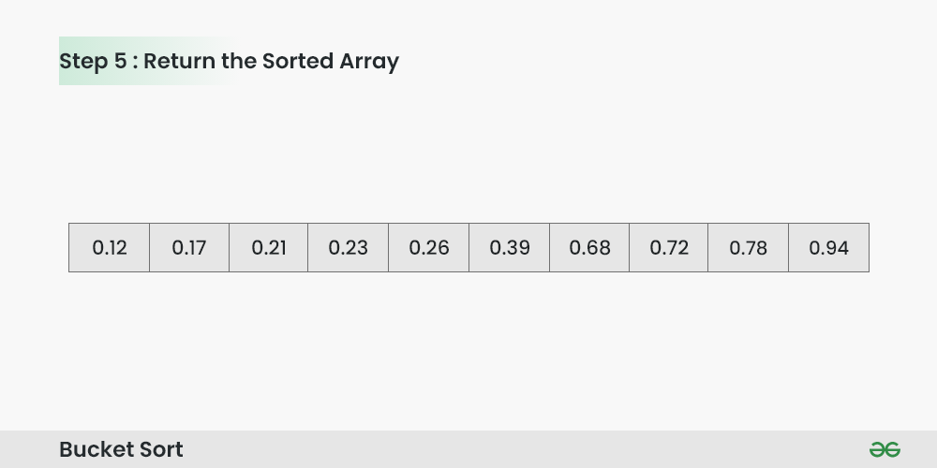
Bucket Sort Algorithm
Step 5: The original array now contains the sorted elements.
The final sorted array using bucket sort for the given input is [0.12, 0.17, 0.21, 0.23, 0.26, 0.39, 0.68, 0.72, 0.78, 0.94].

Slide 47
Complexity Analysis Bucket Sort Algorithm
Worst Case Time Complexity: O(n²) when one bucket gets all the elements.
Best Case Time Complexity : O(n + k) when every bucket gets equal number of elements.
Auxiliary Space: O(n+k)

Slide 48
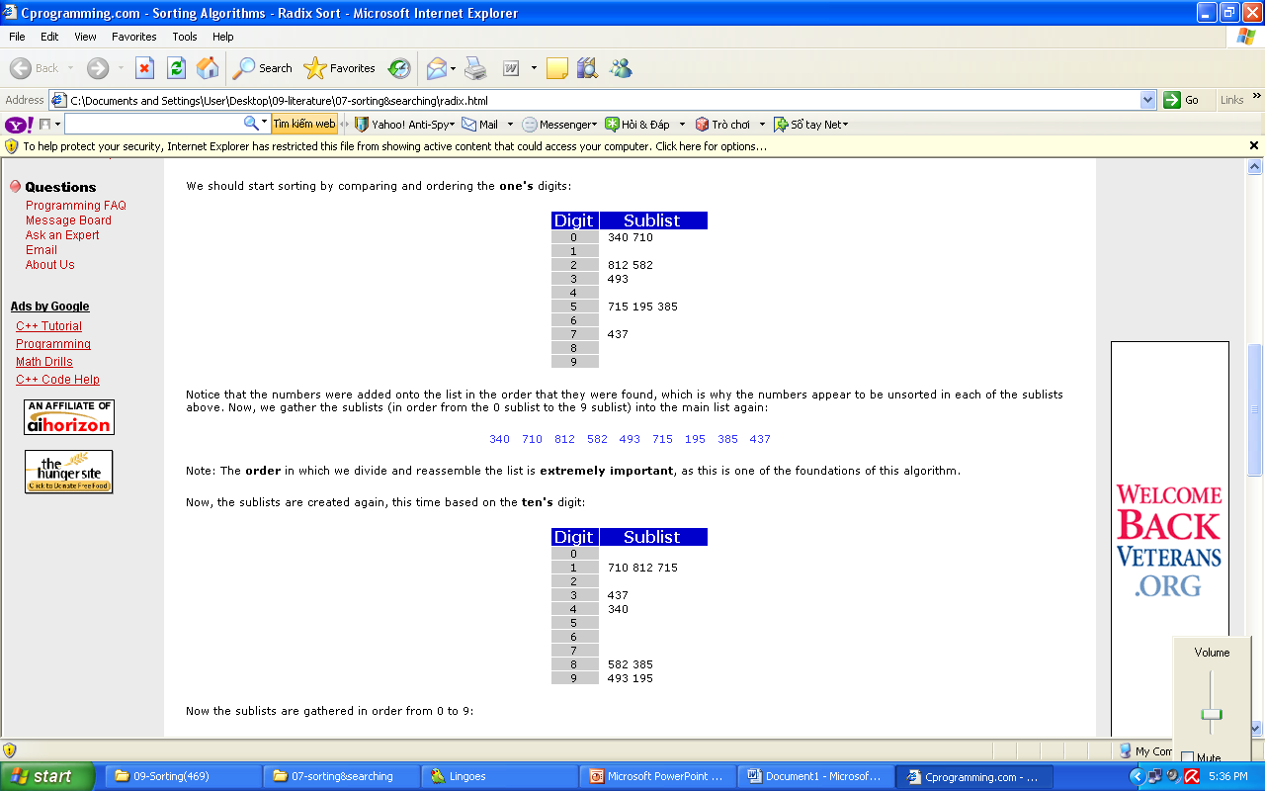
Radix sort - 1
Radix Sort is a clever and intuitive little sorting algorithm. Radix Sort puts the elements in order by comparing the digits of the numbers.
Consider the following 9 numbers:
493 812 715 340 195 437 710 582 385
We should start sorting by comparing and ordering the one's digits:
Notice that the numbers were added onto the list in the order that they were found, which is why the numbers appear to be unsorted in each of the sublists above. Now, we gather the sublists (in order from the 0 sublist to the 9 sublist) into the main list again:
340 710 812 582 493 715 195 385 437
Note: The order in which we divide and reassemble the list is extremely important, as this is one of the foundations of this algorithm.

Slide 49
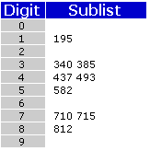
Radix sort - 2
340 710 812 582 493 715 195 385 437
Now, the sublists are created again, this time based on the ten's digit:
Now the sublists are gathered in order from 0 to 9:
710 812 715 437 340 582 385 493 195
Finally, the sublists are created according to the hundred's digit:
At last, the list is gathered up again:
195 340 385 437 493 582 710 715 812
And now we have a fully sorted array! Radix Sort is very simple, and a computer can do it fast. When it is programmed properly, Radix Sort is in fact one of the fastest sorting algorithms for numbers or strings of letters.

Slide 50
Radix sort - 2
Disadvantages
Still, there are some tradeoffs for Radix Sort that can make it less preferable than other sorts.
The speed of Radix Sort largely depends on the inner basic operations, and if the operations are not efficient enough, Radix Sort can be slower than some other algorithms such as Quick Sort and Merge Sort.
These operations include the insert and delete functions of the sublists and the process of isolating the digit you want.

Slide 51
Shell Sort
Shell sort is mainly a variation of Insertion Sort.
The idea of ShellSort is to allow the exchange of far items.
In Shell sort, we make the array h-sorted for a large value of h.
We keep reducing the value of h until it becomes 1.
An array is said to be h-sorted if all sublists of every h’th element are sorted.

Slide 52
Shell Sort Algorithm
Step 1 − Start
Step 2 − Initialize the value of gap size, say h.
Step 3 − Divide the list into smaller sub-part. Each must have equal intervals to h.
Step 4 − Sort these sub-lists using insertion sort.
Step 5 – Repeat this step 2 until the list is sorted.
Step 6 – Print a sorted list.
Step 7 – Stop.

Slide 53
Shell Sort Algorithm
We are using the shell's original sequence (N/2, N/4, ...1) as intervals in our algorithm.
In the first loop, if the array size is N = 8 then, the elements lying at the interval of N/2 = 4 are compared and swapped if they are not in order.
The 0th element is compared with the 4th element.
If the 0th element is greater than the 4th one then, the 4th element is first stored in thetemp variable and the 0th element (ie. greater element) is stored in the 4th position and the element stored in temp is stored in the 0th position.
This process goes on for all the remaining elements.
In the second loop, an interval of N/4 = 8/4 = 2 is taken and again the elements lying at these intervals are sorted.
The elements at the 4th and 2nd positions are compared. The elements at the 2nd and 0th positions are also compared. All the elements in the array lying at the current interval are compared.
Finally, when the interval is N/8 = 8/8 =1 then the array elements lying at the interval of 1 are sorted. The array is now completely sorted.

Slide 54
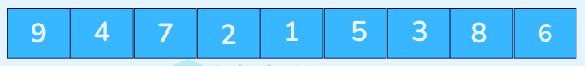
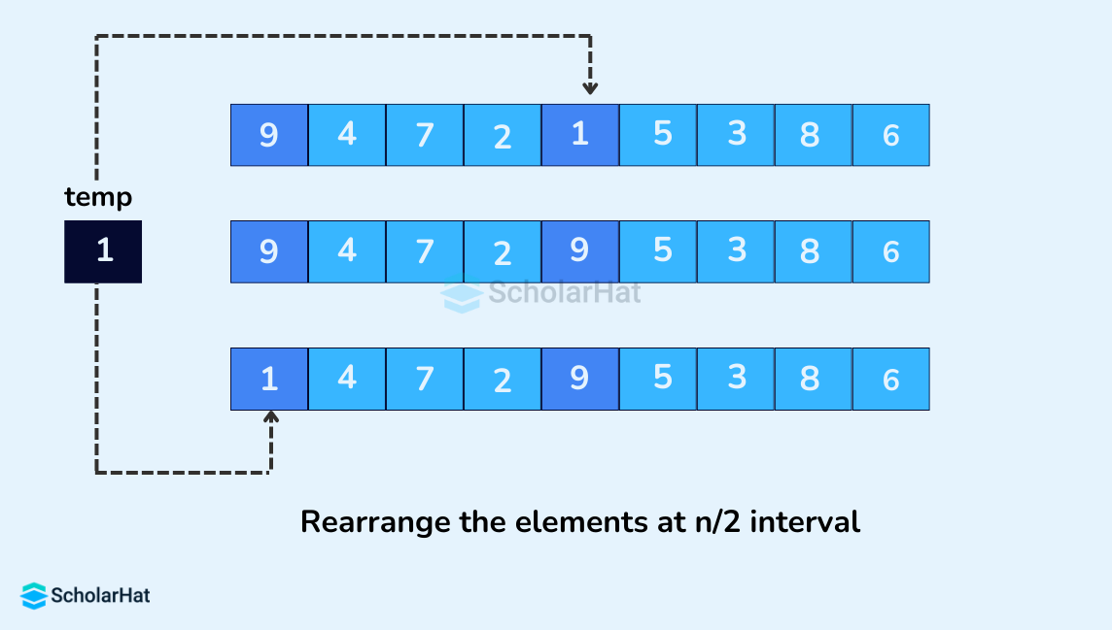
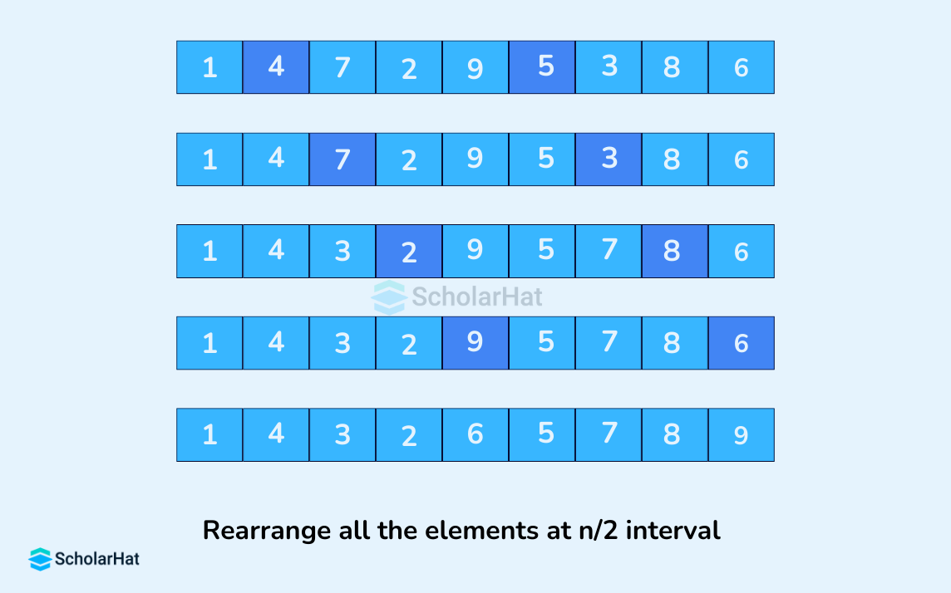
Shell Sort Algorithm

Slide 55
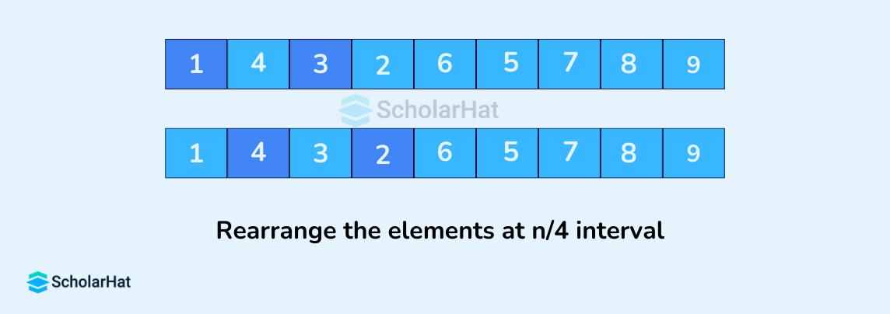
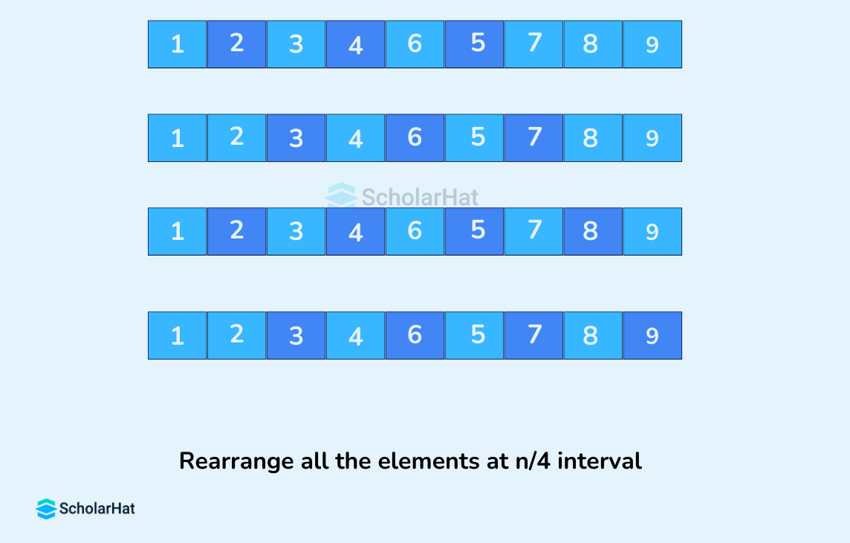
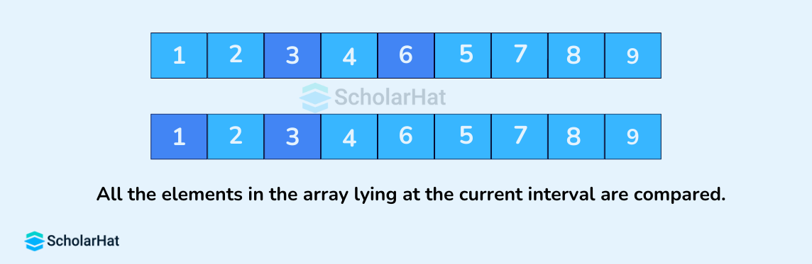
Shell Sort Algorithm

Slide 56
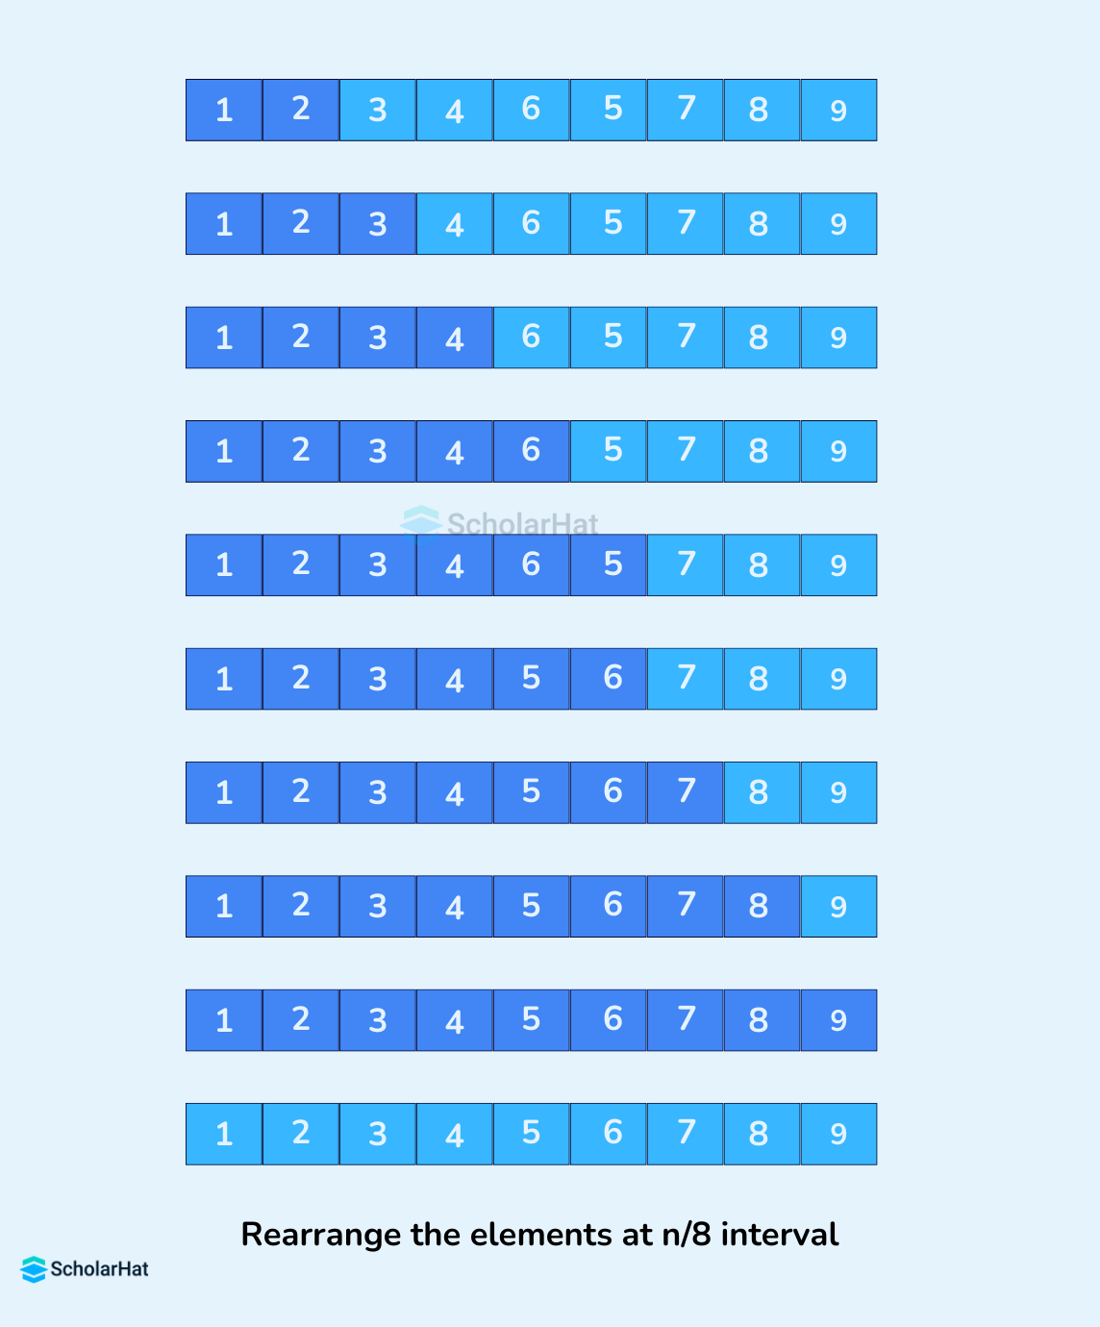
Shell Sort Algorithm

Slide 57
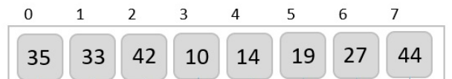
Shell Sort Algorithm

Slide 58
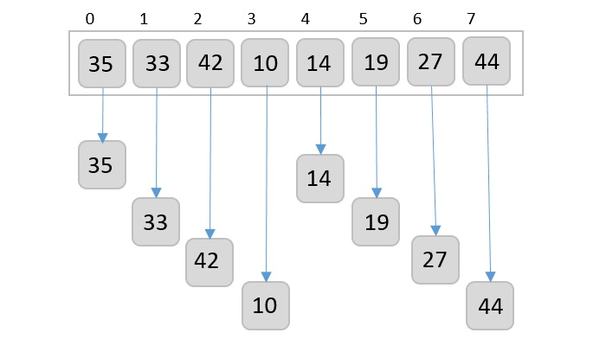
Shell Sort Algorithm
We take the interval of 4. Make a virtual sub-list of all values located at the interval of 4 positions. Here these values are
{35, 14}, {33, 19}, {42, 27} and {10, 14}

Slide 59
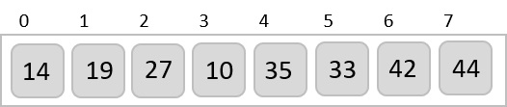
Shell Sort Algorithm
We compare values in each sub-list and swap them (if necessary) in the original array. After this step, the new array should look like

Slide 60
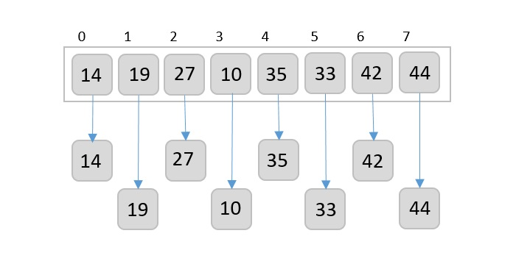
Shell Sort Algorithm
We compare values in each sub-list and swap them (if necessary) in the original array. After this step, the new array should look like

Slide 61
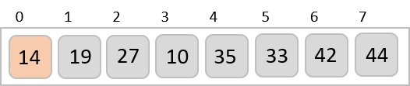
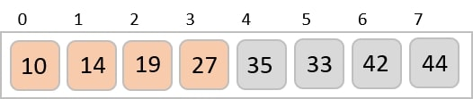
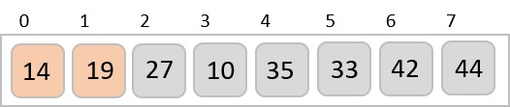
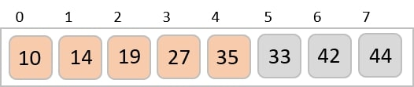
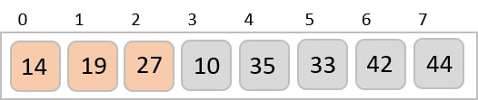
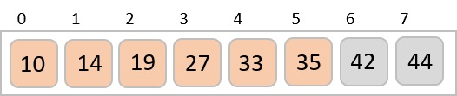
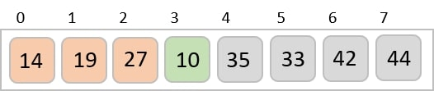
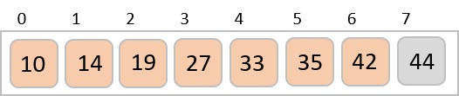



Shell Sort Algorithm
we sort the rest of the array using interval of value 1. Shell sort uses insertion sort to sort the array

Slide 62
Counting Sort Algorithm
Counting Sort is a non-comparison-based sorting algorithm.
It is particularly efficient when the range of input values is small compared to the number of elements to be sorted.
The basic idea behind Counting Sort is to count the frequency of each distinct element in the input array and use that information to place the elements in their correct sorted positions.

Slide 63
Counting Sort Algorithm
Declare an auxiliary array countArray[] of size max(inputArray[])+1 and initialize it with 0.
Traverse array inputArray[] and map each element of inputArray[] as an index of countArray[] array, i.e., execute countArray[inputArray[i]]++ for 0 <= i < N.
Calculate the prefix sum at every index of array inputArray[].
Create an array outputArray[] of size N.
Traverse array inputArray[] from end and update outputArray[ countArray[ inputArray[i] ] – 1] = inputArray[i]. Also, update countArray[ inputArray[i] ] = countArray[ inputArray[i] ]- – .

Slide 64




Counting Sort Algorithm
Find out the maximum element from the given array.
Initialize a countArray[] of length max+1 with all elements as 0. This array will be used for storing the occurrences of the elements of the input array.
In the countArray[], store the count of each unique element of the input array at their respective indices.
Store the cumulative sum or prefix sum of the elements of the countArray[] by doing countArray[i] = countArray[i – 1] + countArray[i]. This will help in placing the elements of the input array at the correct index in the output array.

Slide 65

Counting Sort Algorithm
Iterate from end of the input array and because traversing input array from end preserves the order of equal elements, which eventually makes this sorting algorithm stable.

Slide 66

Counting Sort Algorithm
Update
outputArray[ countArray[ inputArray[6] ] – 1] = inputArray[6]
countArray[ inputArray[6] ] = countArray[ inputArray[6] ]- –

Slide 67

Counting Sort Algorithm
Update
outputArray[ countArray[ inputArray[5] ] – 1] = inputArray[5] countArray[ inputArray[5] ] = countArray[ inputArray[5] ]- –

Slide 68

Counting Sort Algorithm
Update
outputArray[ countArray[ inputArray[4] ] – 1] = inputArray[4] countArray[ inputArray[4] ] = countArray[ inputArray[4] ]- –

Slide 69

Counting Sort Algorithm
Update
outputArray[ countArray[ inputArray[3] ] – 1] = inputArray[3] countArray[ inputArray[3] ] = countArray[ inputArray[3] ]- –

Slide 70

Counting Sort Algorithm
Update
outputArray[ countArray[ inputArray[1] ] – 1] = inputArray[1] countArray[ inputArray[1] ] = countArray[ inputArray[1] ]- –

Slide 71

Counting Sort Algorithm
Update
outputArray[ countArray[ inputArray[0] ] – 1] = inputArray[0] countArray[ inputArray[0] ] = countArray[ inputArray[0] ]- –

Slide 72

Counting Sort Algorithm
Update
outputArray[ countArray[ inputArray[2] ] – 1] = inputArray[2] countArray[ inputArray[2] ] = countArray[ inputArray[2] ]- –

Slide 73
Sorting in java.util - 1
Java provides two sets of versions of sorting methods: one for arrays and one for lists
The utility class Arrays includes a method for:
Searching arrays for elements with binary search
Filling arrays with a particular value
Converting an array into a list, and sorting methods

Slide 74
Sorting in java.util - 2
The sorting methods are provided for arrays with elements of all elementary types except Boolean
For each type of sorting method there are two versions:
One for sorting an entire array
One for sorting a subarray
public static void sort(int[] a);
public static void sort(int[] a, int first, int last);

Slide 75

Complexity

Slide 76


Exercise
Select the most correct statement about the complexity of mergesort

Slide 77

Exercise
Select the most correct statement about the complexity of selection sort
A. Both best and worst cases are O(n^2)
B. The best case is O(n), and the worst case is O(n^2)
C. The best case is O(n), and the average case is O(nlogn)
D. The best case is O(n), and the average case is O(n^2)

Slide 78



Exercise
Sort the following list using the Selection Sort algorithm: H, V, A, T, L, N, K
What is the output of the algorithm after the third pass?
1. A, V, T, H, L, N, K
2. A, T, H, K, L, N, V
3. A, V, H, T, L, N, K
4. A, H, K, T, L, N, V

Slide 79

Exercise
How many swaps are required for the given array 1 and array 2 using selection sort respectively?
Note: The sorted array should be in increasing order.
Array 1: 7 6 8 5 9 4 10 3
Array 2: 10 9 8 7 6 5 4 3
6,4
7,7
7,8
7,0

Slide 80

Exercise
An array of 5 numbers has the following entries in order: 7 4 5 10 8. Prashant uses selection sort to sort this array in descending order. What will the array contain after two iterations of selection sort?
10 8 7 5 4
10 8 5 7 4
8 10 5 7 4
None of these

Slide 81

Exercise
Algorithm design technique used in quick sort algorithm is
Dynamic programming
Backtracking
Divide and Conquer
Greedy Method

Slide 82

Exercise
Randomized quicksort is an extension of quicksort where the pivot is chosen randomly. What is the worst case complexity of sorting n number using randomized quicksort?
O (n)
O(n log n)
O(n^2)
O(n!)

Slide 83

Exercise
Partitioning is a technique used in quicksort. The following is a partition pseudocode for sorting from smallest to largest:
partition the array a from index low to index up
x := a[low], i=low, j=up
do
increase i and stop at i, where a[i]>x
decrease j and stop at j, where a[j] <= x
if(i<j) swap a[i] with alj]
while(i<j)
swap a[low] with a[j]
Consider the list of eight integers (n=8) below:
7, 4, 10, 11, 9, 3, 8, 6
What is the list after it is partitioned with low = 0 and up = n-1?

Slide 84


Exercise
Select the most correct statement about the complexity of bubblesort

Slide 85

Exercise
The following is the main part of bubble sort pseudocode:
do
swapped := false
for i := 0 to n-2
if a[i] > a[i+1] then
swap(a[i],a[i+1])
swapped := true
end if
end for
while swapped
Consider the list of ten integers below:
6, 4, 9, 10, 2, 8, 1, 3, 7, 5
What is the list after the FIRST iteration (for i = 0 to n-2) in a bubble sort? (sorting from smallest to largest).

Slide 86
Exercise
The number of swappings needed to sort the numbers 8, 22, 7, 9, 31, 5, 13 in ascending order, using bubble sort is
A. 11
B. 12
C. 13
D. 10

Slide 87

Exercise
Arrange the following items in ascending order using Bubble Sort. What is the intermediate sequence of 37, 54, 21, 85, 68, 12, 9, and 57 after the second pass?
A. 21, 37, 12, 9, 54, 57, 68, 85
B. 37, 21, 54, 68, 12, 9, 57, 85
C. 21, 12, 9, 37, 54, 57, 68, 85
D. 21, 37, 54, 12, 9, 57, 68, 85

Slide 88

Exercise
Select the most correct statement:
A. In all cases the insertion sort is O(n^2).
B. The complexity of insertion sort is O(n^2), in the best case it is O(n).
C. The complexity of insertion sort is O(nlog n), in the best case it is O(n).
D. The complexity of insertion sort is O(n^2), in the best case it is O(nlogn).

Slide 89
Exercise
Consider the following array and what is the status of the array after the fifth pass when we use the insertion sort?
Input: 4 3 2 10 12 15 6
Output: 1 2 3 4 5 6 10 12
After the first pass: 3 4 2 10 12 1 5 6
1 2 3 4 10 12 5 6
3 4 2 10 12 1 5 6
2 3 4 10 12 1 5 6
1 2 3 4 5 10 12 6

Slide 90

Exercise
The following is the main part of insertion sort pseudocode:
for i := 1 to n-1
insert a[i] into sorted sublist {a[0], ... ,a[i-1]}
so that the sortedness is still kept.
end for
Select the most correct solution:
Consider the list of ten integers below:
16, 5, 3, 11, 10, 8, 12, 4, 8, 6
What is the list after the FIRST TWO steps of insertion sort? (sorting from smallest to largest).

Slide 91

Exercise
The complexity of heap sort is
A. O(nlog n)
B. O(log n)
C. O(n)
D. O(n^2)

Slide 92

Exercise
2
3
4
5
6

Slide 93

Exercise
2
3
4
5

Slide 94
Summary
Elementary Sorting Algorithms
Selection Sort
Insertion Sort
Bubble Sort
Efficient Sorting Algorithms
Quick Sort
Merge Sort
Heap sort
Radix Sort
Sorting in java.util

Slide 95
Reading at home
Text book: Data Structures and Algorithms in Java
12 Sorting and Selection 531
9.4.1 Selection-Sort and Insertion-Sort - 386
bubble-sort (see Exercise C-7.51)
12.2 Quick-Sort - 544
12.1 Merge-Sort - 532
9.4.2 Heap-Sort - 388
12.3.2 Linear-Time Sorting: Bucket-Sort and Radix-Sort - 558
12.4 Comparing Sorting Algorithms - 561

